Slide 1


Project
presentation
Presented By
Abinav Prabhu 23MIA1170
Shailendra Kumar 23MIA1139
Vishnu Priya 23MIA1039

Slide 2
ABSTRACT
The current work investigates electric vehicle (EV) trends within Washington State from a dataset containing more than 230,000 records. By pre-processing, applying statistical analysis and clustering (K-Means and hierarchical), the study identifies adoption patterns as well as drivers such as MSRP, Electric range and legislative districts. Outcomes enable policy and business planning for EV adoption.

Slide 3
OBJECTIVES
-->Clean and prepare the EV dataset.
-->Analyze key features through EDA.
-->Handle outliers and missing values.
-->Apply clustering to segment EVs.
-->Visualize adoption patterns across time and regions.

Slide 4
PROPOSED METHODOLOGY
Data Cleaning: Removed missing/zero values in crucial fields.
Imputation: Applied mean/median filling for gaps.
Outlier Detection: Used IQR and boxplots.
Statistical Analysis: Performed skewness, kurtosis, correlation checks.
Clustering: Applied hierarchical and K-Means clustering.
Visualization: Created plots with heatmaps, histograms, and pie charts.

Slide 5
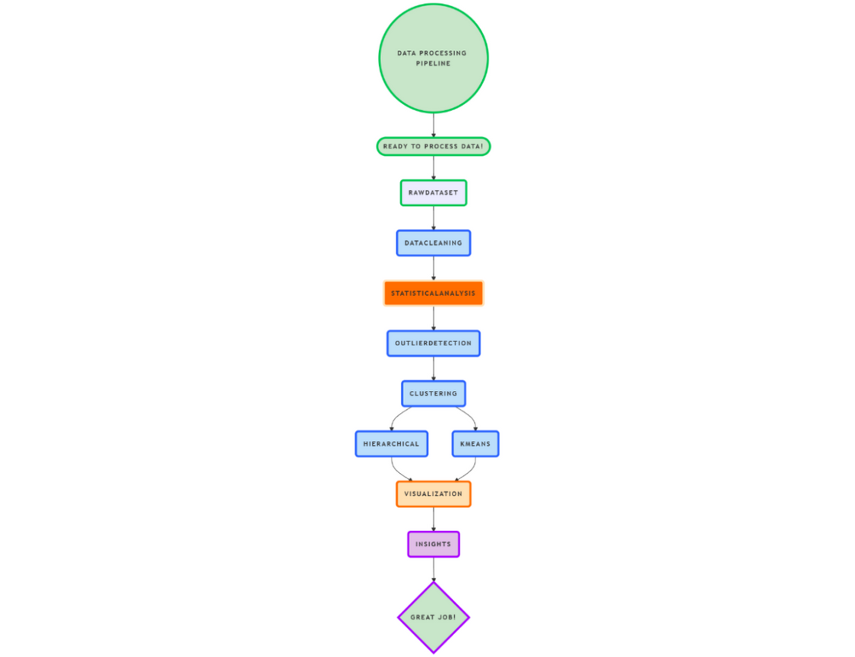
ARCHITECTURE DIAGRAM

Slide 6
MODULE DESCRIPTION
Hierarchical Clustering
Used 1,000 samples with Ward’s method.
Identified ~4 optimal clusters from dendrogram.
K-Means Clustering
Based on MSRP and electric range.
Elbow method confirmed 4 clusters.
Scatter plot revealed distinct groupings.

Slide 7
DATASET
Dataset Link: https://catalog.data.gov/dataset/electric-vehicle-population-data
Source: Public data from Washington State
Size: 235,000 rows × 17 columns
Important Features: Model year, Make, EV type, Electric range, Base MSRP, County, City, Legislative district

Slide 8
RESULT
Top Counties: King County leads in EV count.
Popular Models: Tesla Model Y and 3 top the list.
Growth Trend: Surge in EV adoption post-2015, peaking in 2023.
EV Type: BEV and PHEV are evenly distributed.
Mileage Leaders: Jaguar and Tesla offer the longest range.
Cluster Summary:
Cluster 1: Low cost, low range
Cluster 2: Mid-range
Cluster 3: High range & cost
Cluster 4: Luxury outliers

Slide 9
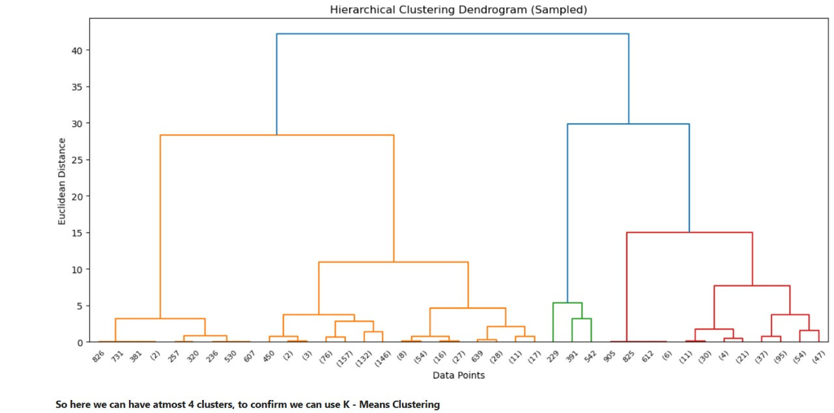
RESULT

Slide 10
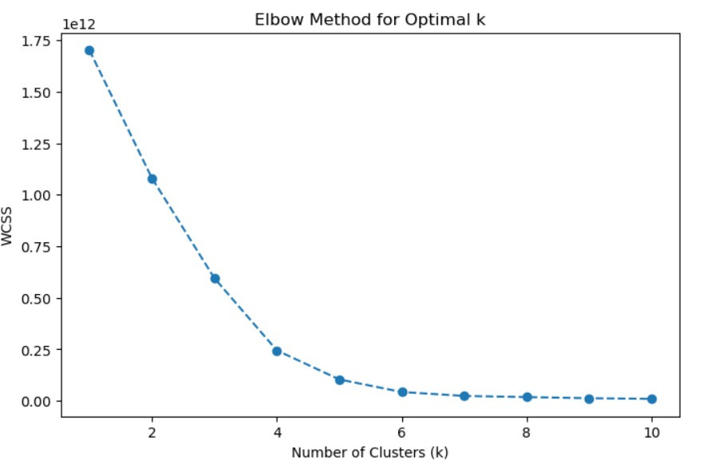
RESULT

Slide 11
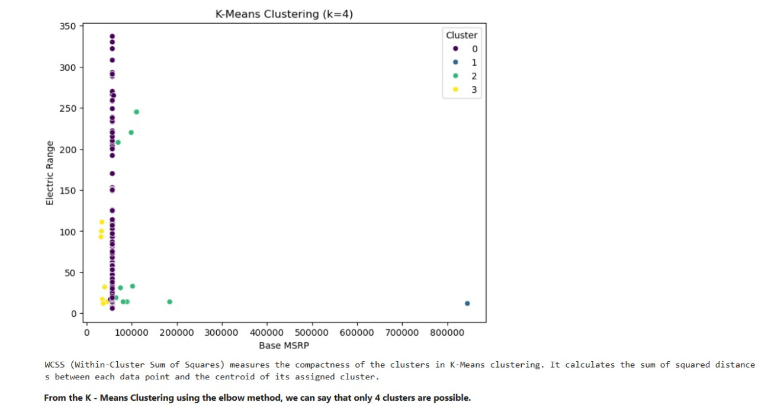
RESULT

Slide 12
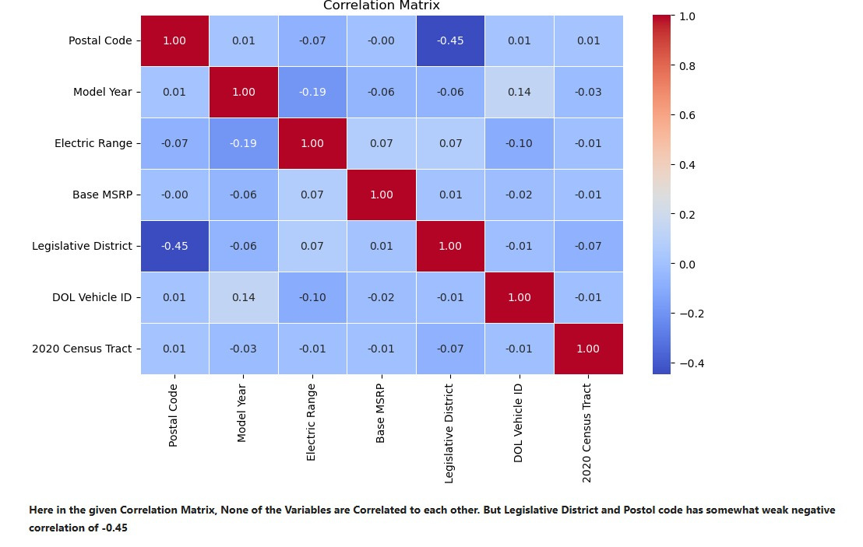
RESULT

Slide 13
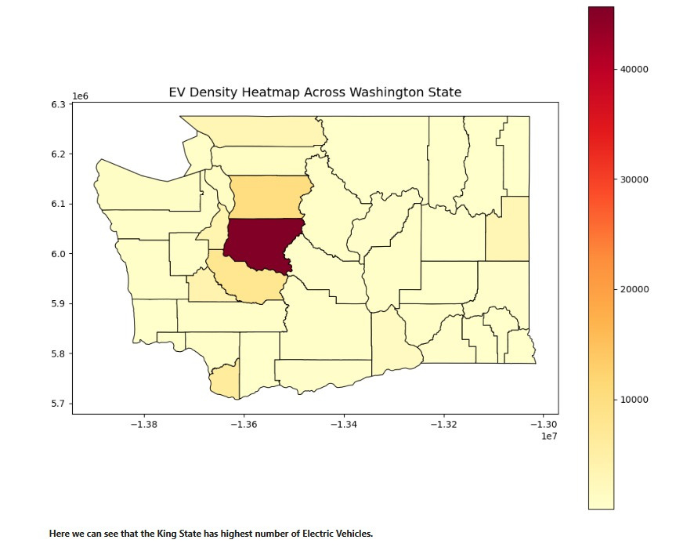
RESULT

Slide 14
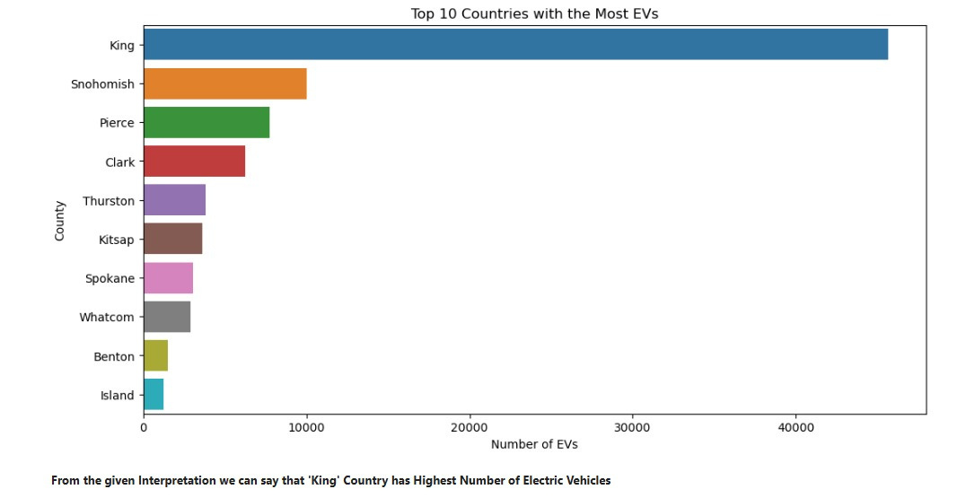
RESULT

Slide 15
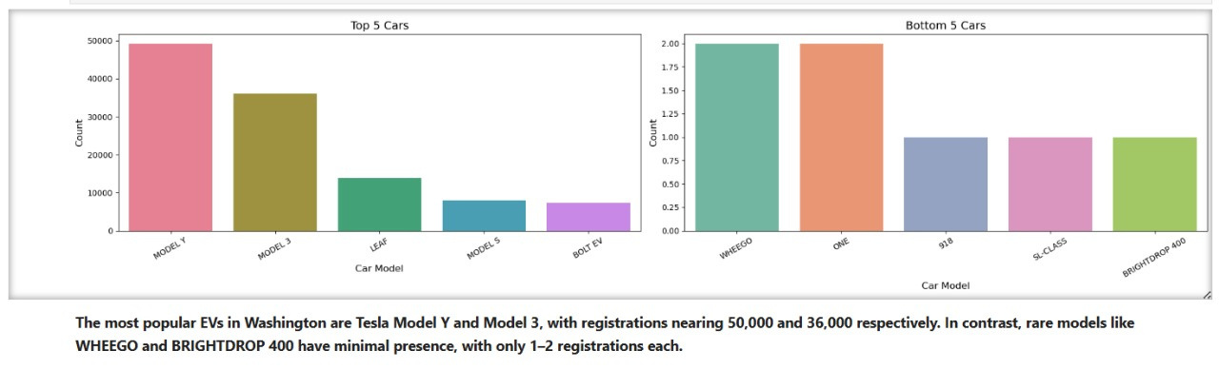
RESULT

Slide 16
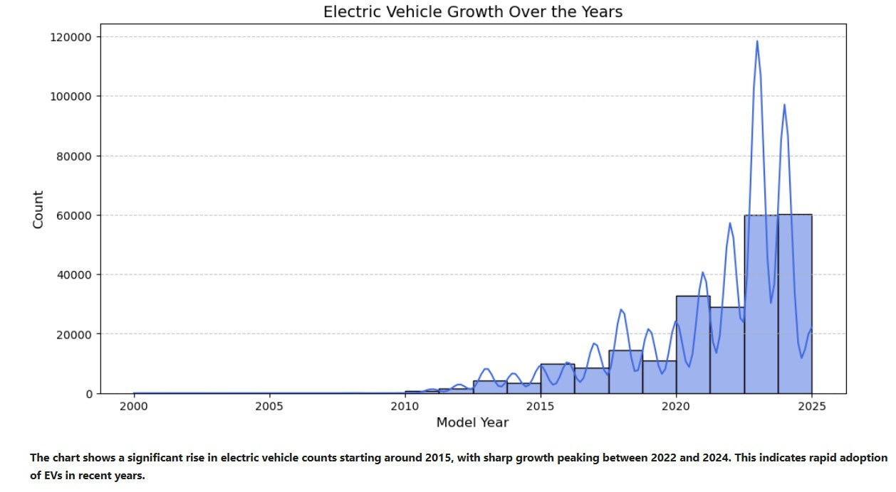
RESULT

Slide 17
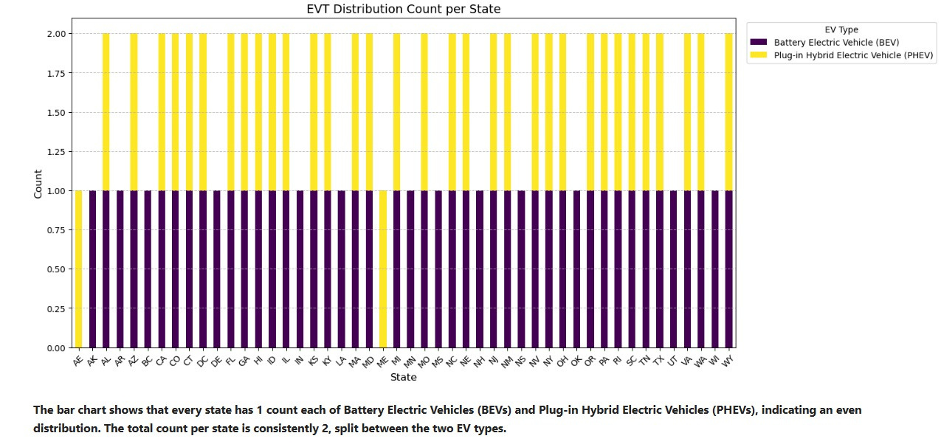
RESULT

Slide 18
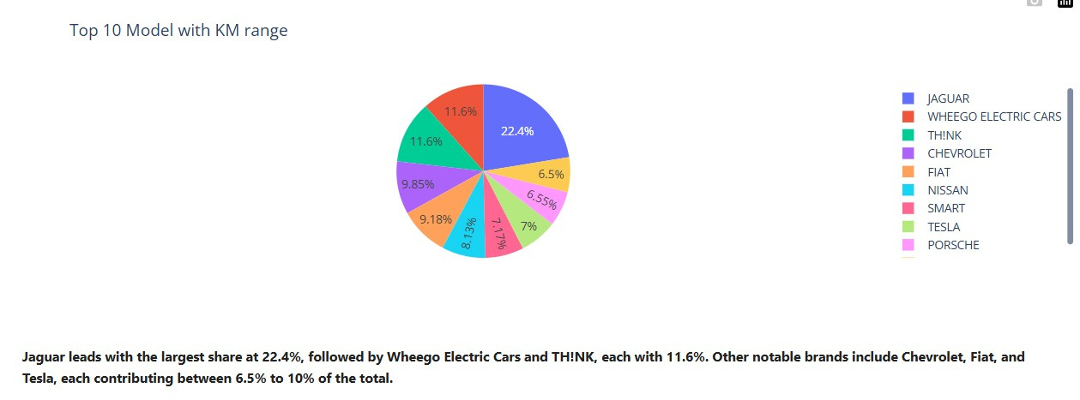
RESULT

Slide 19
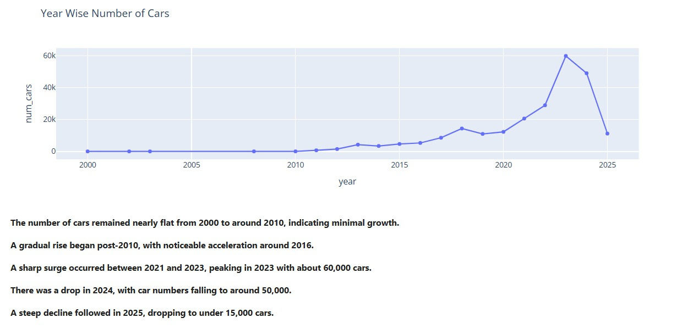
RESULT

Slide 20
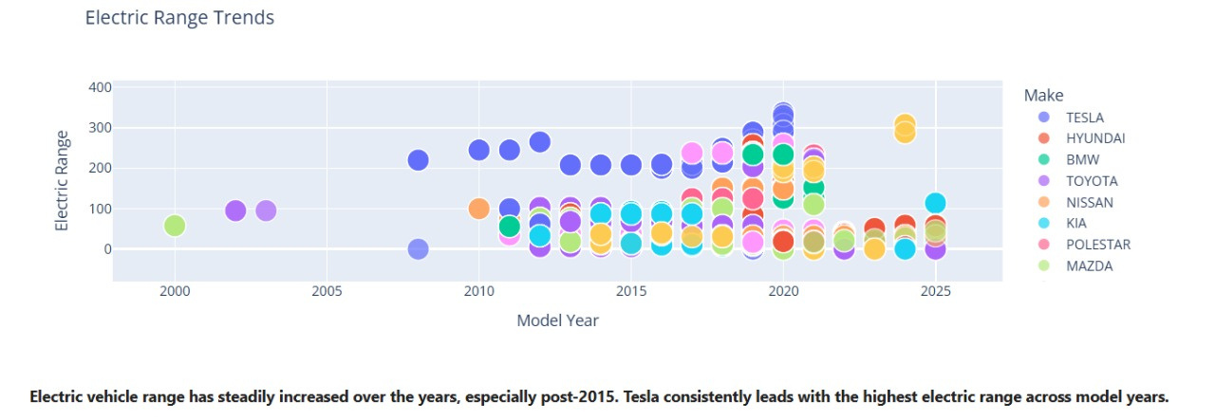
RESULT

Slide 21
CONCLUSION
Clustering revealed distinct EV market segments, supporting targeted strategies for stakeholders. The rise in EVs reflects growing green transport interest. This project demonstrates the impact of EDA and machine learning in policy and market insights.

Slide 22

GITHUB LINK
https://github.com/RadheKrishna-RadheRadhe/EV_Data-Analysis/tree/main
The Following GitHub Link Contains the full Data Analysis Report in format of Python Notebook file (.ipynb) and pdf File (.pdf), the following link also contains the shape file (.shp) of Washington State.

Slide 23
REFERENCES
https://data.wa.gov/Transportation/Electric-Vehicle-Population-Data/f6w7-q2d2/about_data
https://catalog.data.gov/dataset/electric-vehicle-population-data
https://sdgresources.relx.com/electric-vehicles-evs#:~:text=EVs%20also%20play%20a%20role,which%20has%20significant%20health%20impacts
https://sdgresources.relx.com/goal-7-affordable-and-clean-energy
https://sdgresources.relx.com/goal-11-sustainable-cities-and-communities
https://sdgresources.relx.com/goal-13-climate-action

Slide 24
THANK
YOU

